Slide 1

On “One-of-the-few” Objects
You Wu, Pankaj K. Agarwal, Jun Yang | Duke University
Chengkai Li | University of Texas, Arlington
Cong Yu | Google, Inc.
Notes:
Deeper color for bullets

Slide 2
“One of the Few” Claims
Sports: Karl Malone is ONE OF THE ONLY TWO players in NBA history with 25,000 points, 12,000 rebounds, and 5,000 assists in one’s career
Politics: He is ONE OF THE ONLY THREE candidates who have raised more than 25% from PAC contributions and 25% from self-financing
Do these claims really hold water?
How do we find truly interesting claims or individuals?

Slide 3
Applications
Computational journalism: use computing to help
Increase effectiveness and reduce cost
Improve understanding and broaden participation
Guard against “lies, damned lies, and statistics”
Usability is key!
We target “one of the few” claims in this paper
Domains include
Sports; election campaign finance; government, education, and business performance indexes
Or in general, wherever objects are compared across many dimensions

Slide 4

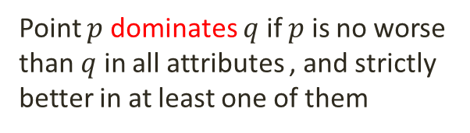
Key Challenges
General claim: fewer than $k$ objects dominate $X$ in subspace of attributes $S⊆\left\{A_{1}, A_{2}, …, A_{d}\right\}$
He is ONE OF THE ONLY TWO players with 25,000 points, 12,000 rebounds, and 5,000 assists
Point $p$ dominates $q$ if $p$ is no worse than $q$ in all attributes , and strictly better in at least one of them

Slide 5
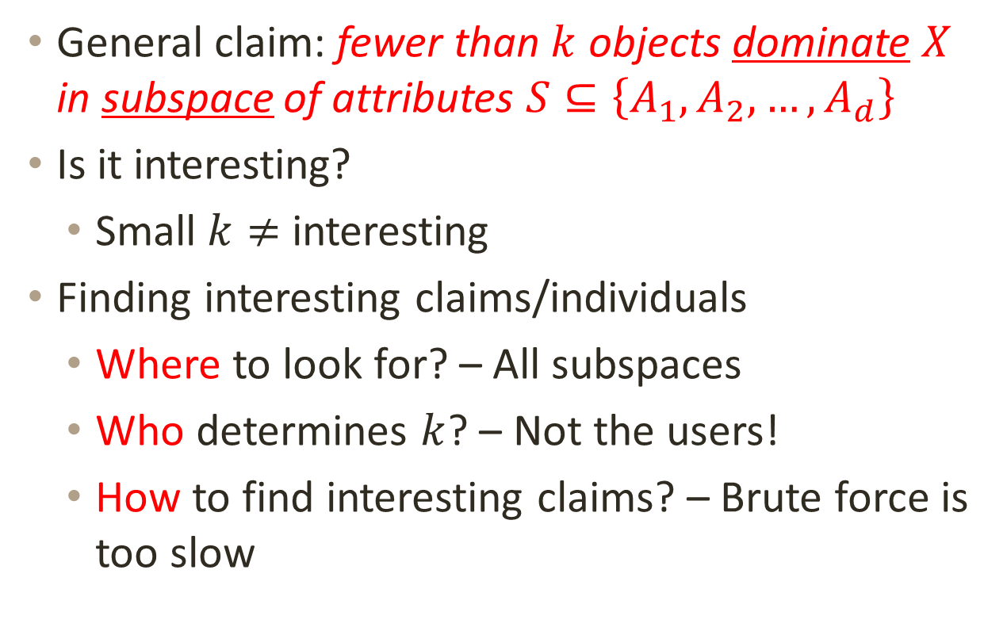
Key Challenges
General claim: fewer than $k$ objects dominate $X$ in subspace of attributes $S⊆\left\{A_{1}, A_{2}, …, A_{d}\right\}$
Is it interesting?
Small $k≠$ interesting
Finding interesting claims/individuals
Where to look for? – All subspaces
Who determines $k$? – Not the users!
How to find interesting claims? – Brute force is too slow
Notes:
one-of-5 claims on {points, rebounds, assists} can be made for 54 players!
Where to look for interesting claims
Letting user specify what value of $k$ to use for each subspace is practically infeasible
Examining each of the $2^{d}−1$ subspaces with brute force is computationally infeasible

Slide 6
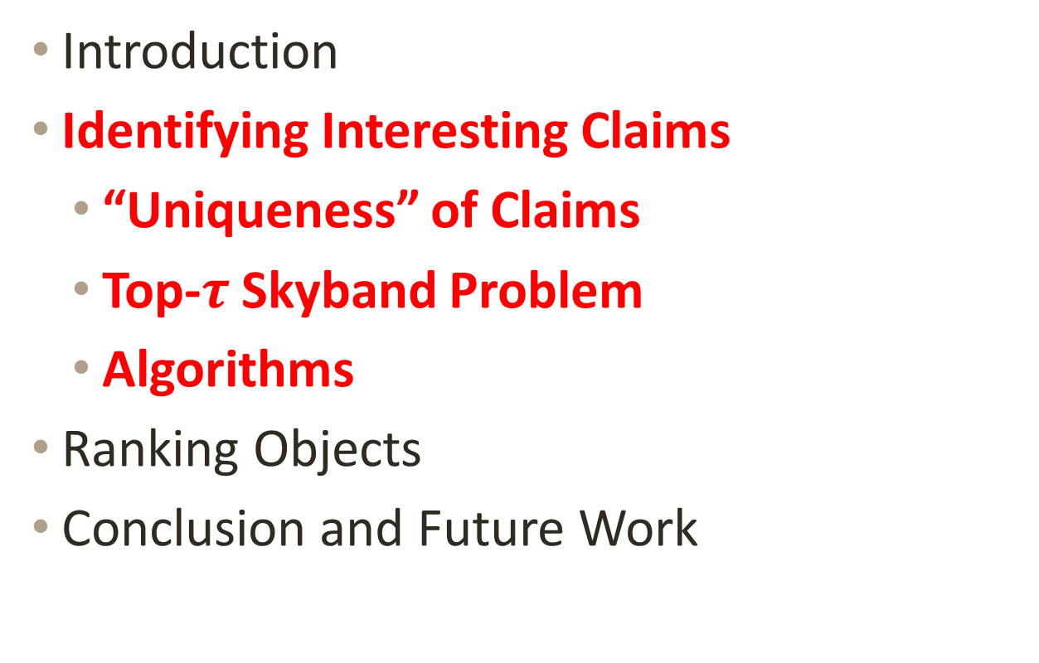
Roadmap
Introduction
Identifying Interesting Claims
“Uniqueness” of Claims
Top-$τ$ Skyband Problem
Algorithms
Ranking Objects
Conclusion and Future Work

Slide 7
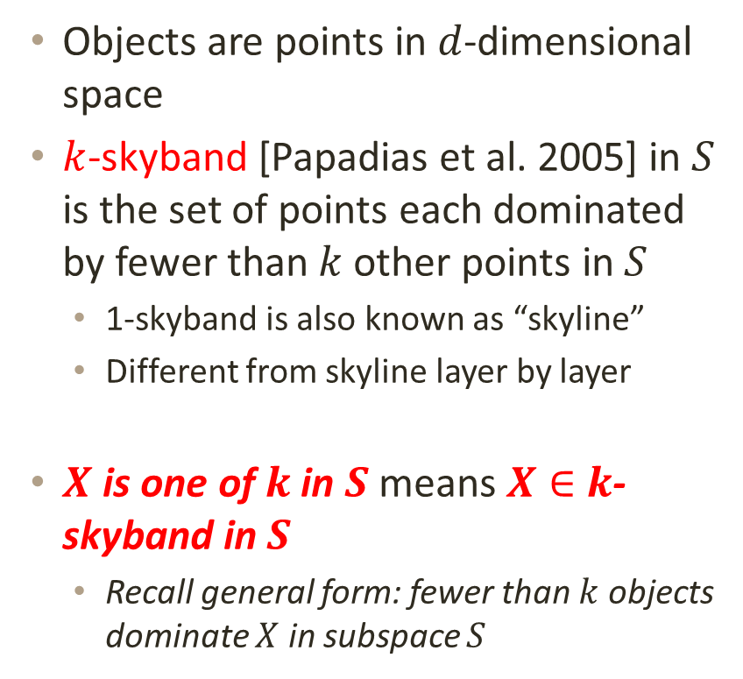
Data Model and Preliminaries
Objects are points in $d$-dimensional space
$k$-skyband [Papadias et al. 2005] in $S$ is the set of points each dominated by fewer than $k$ other points in $S$
1-skyband is also known as “skyline”
Different from skyline layer by layer
$X$ is one of $k$ in $S$ means $X∈$ $k$-skyband in $S$
Recall general form: fewer than $k$ objects dominate $X$ in subspace $S$
1-skyband
2-skyband
1st layer
2nd layer

Slide 8

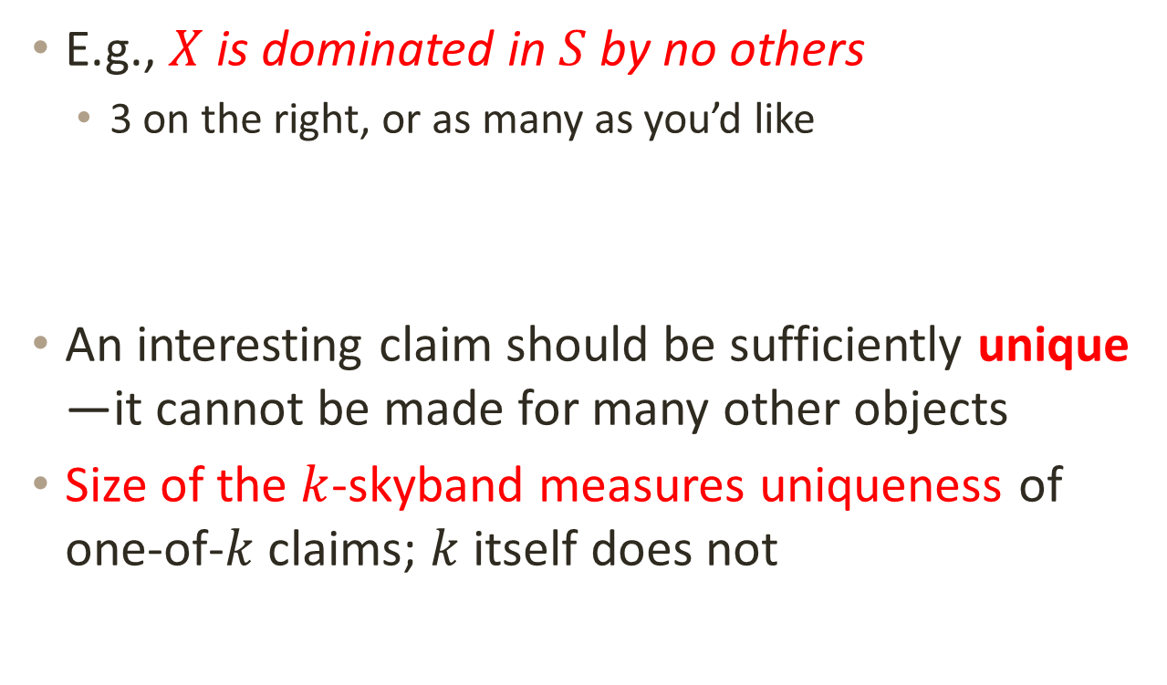
Small $k≠$ Interesting
E.g., $X$ is dominated in $S$by no others
3 on the right, or as many as you’d like
An interesting claim should be sufficiently unique —it cannot be made for many other objects
Size of the $k$-skyband measures uniqueness of one-of-$k$ claims; $k$ itself does not
Notes:
may sound impressive because $k=1$, but there can be many objects like $X$

Slide 9

Finding Unique Claims: Challenges
Existing skyband algorithms require user to pick $k$
But to ensure uniqueness, choice of $k$ depends on subspace dimensionality
E.g. 2-skyand in {rebounds} vs. in {rebounds, assists}
Stockton
Stockton
Robertson
Robertson
James
Bird
James
Bird
Jordan
Baylor
Chamberlain
Jordan
Baylor
Chamberlain
Abdul-Jabbar
Pettit
Abdul-Jabbar
Pettit

Slide 10

Finding Unique Claims: Challenges
To ensure uniqueness, choice of $k$ also depends on data distribution
Anti-correlated attribute values make skybands bigger
E.g.:
(Correlated) vs. (Anti-Correlated)
Chamberlain
Stockton
Pettit
Robertson
Baylor
James
Bird
Abdul-Jabbar
Chamberlain
Bird
Jordan
Baylor
Johnson
James
Robertson
Jordan
Abdul-Jabbar
Pettit
Stockton
Notes:
Lighter color for names, darker color for points

Slide 11

Finding Unique Claims: Solution
Using same $k$ for all subspaces doesn’t work
Making user pick $k$ for each subspace is infeasible
Our solution: top-$τ$ skyband
User specifies a single parameter $τ$ to cap # skyband objects
For each subspace $S$, find its top-$τ$ skyband, i.e., the largest $k$-skyband containing no more than $τ$ objects
E.g., in {points, rebounds}:
$τ=2→$ 1-skyband (size 2)
$τ=6→$ 2-skyband (size 5; 3-skyband would be too big)
Chamberlain
Pettit
Baylor
Abdul-Jabbar
Bird
Johnson
James
Robertson
Jordan
Stockton

Slide 12

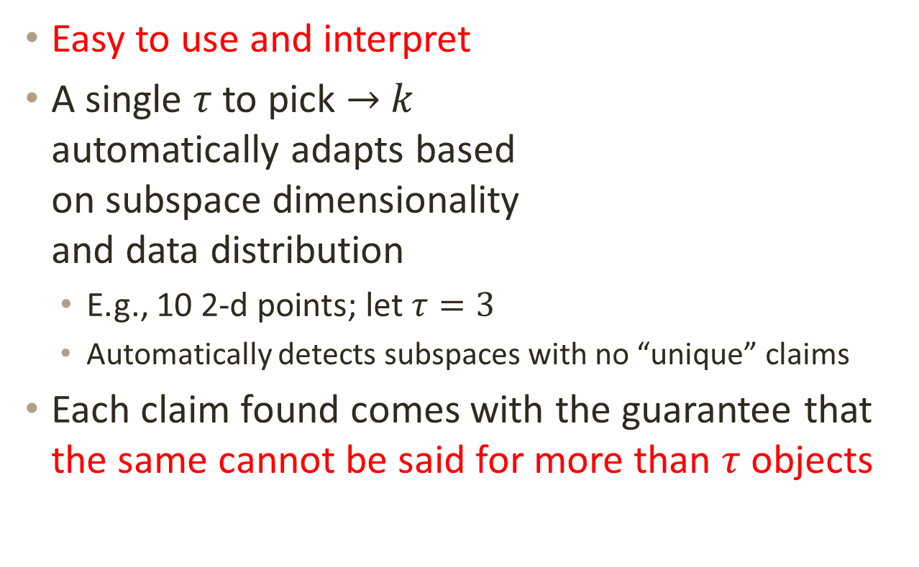
Advantages of Top-$τ$ Formulation
Chamberlain
Easy to use and interpret
A single $τ$ to pick $→$ $k$ automatically adapts based on subspace dimensionality and data distribution
E.g., 10 2-d points; let $τ=3$
Automatically detects subspaces with no “unique” claims
Each claim found comes with the guarantee that the same cannot be said for more than $τ$ objects
Pettit
Baylor
Abdul-Jabbar
Bird
Johnson
James
Robertson
Jordan
Stockton
Notes:
In {points}: Jordan, Chamberlain, James ($k=3$) In {rebounds}: Chamberlain, Pettit, Baylor ($k=3$) In {points, rebounds}: Chamberlain, Jordan ($k=1$)

Slide 13

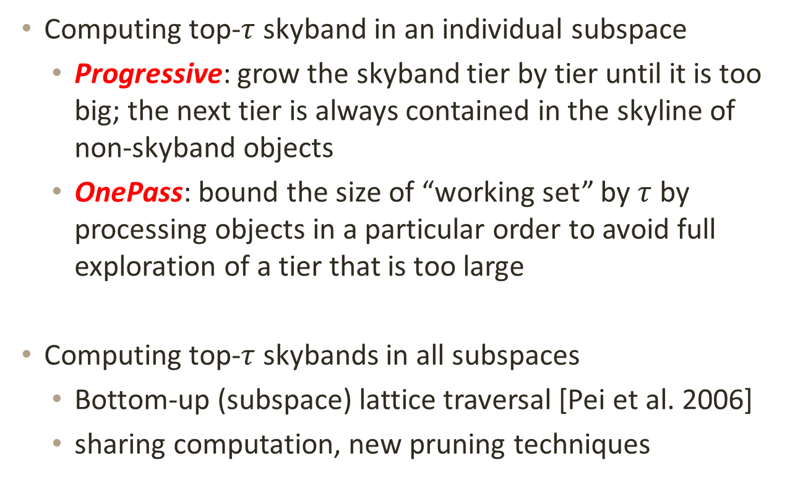
Computing Top-$τ$ Skybands
Computing top-$τ$ skyband in an individual subspace
Progressive: grow the skyband tier by tier until it is too big; the next tier is always contained in the skyline of non-skyband objects
OnePass: bound the size of “working set” by $τ$ by processing objects in a particular order to avoid full exploration of a tier that is too large
Computing top-$τ$ skybands in all subspaces
Bottom-up (subspace) lattice traversal [Pei et al. 2006]
sharing computation, new pruning techniques
Notes:
High-level insights are similar to those in [Pei et al. 2006] for computing skylines in all subspaces, but we have different sharing and new pruning techniques

Slide 14

Performance on NBA career total data
$$τ$$

Slide 15
Roadmap
Introduction
Identifying Interesting Claims
Ranking Objects
Existing Solutions
Adjustable Positional Score with Ties
Conclusion and Future Work

Slide 16
Ranking Objects
Sometimes we are more interested in investigating objects that show up in claims than individual claims per se
Need to rank objects by their “interestingness”
Grouping claims by the objects they mention also helps user navigate through numerous claims

Slide 17
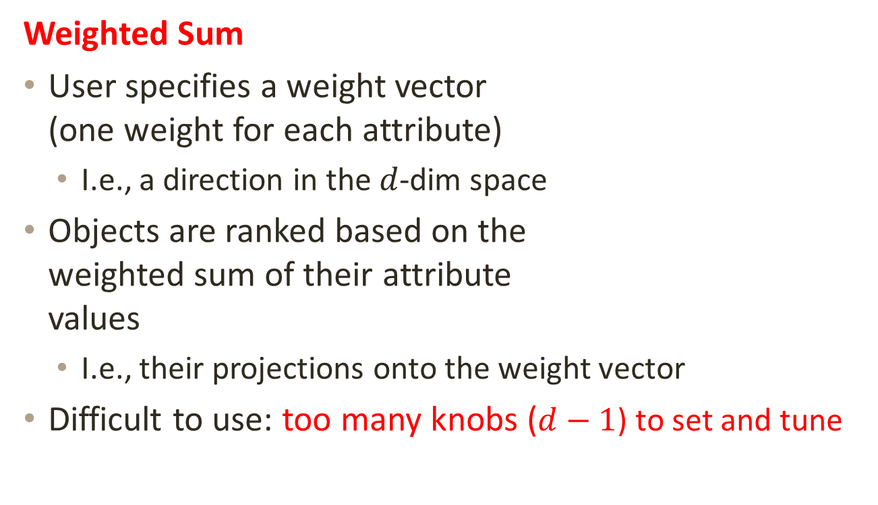
Existing Methods: Valued-Based
Weighted Sum
User specifies a weight vector (one weight for each attribute)
I.e., a direction in the $d$-dim space
Objects are ranked based on the weighted sum of their attribute values
I.e., their projections onto the weight vector
Difficult to use: too many knobs ($d−1$) to set and tune

Slide 18
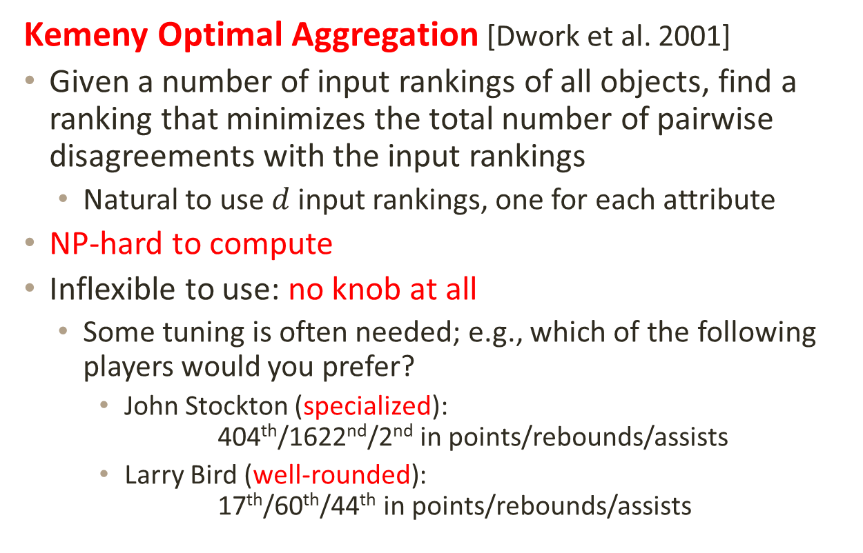
Existing Methods: Rank-Based
Kemeny Optimal Aggregation [Dwork et al. 2001]
Given a number of input rankings of all objects, find a ranking that minimizes the total number of pairwise disagreements with the input rankings
Natural to use $d$ input rankings, one for each attribute
NP-hard to compute
Inflexible to use: no knob at all
Some tuning is often needed; e.g., which of the following players would you prefer?
John Stockton (specialized): 404th/1622nd/2nd in points/rebounds/assists
Larry Bird (well-rounded): 17th/60th/44th in points/rebounds/assists

Slide 19
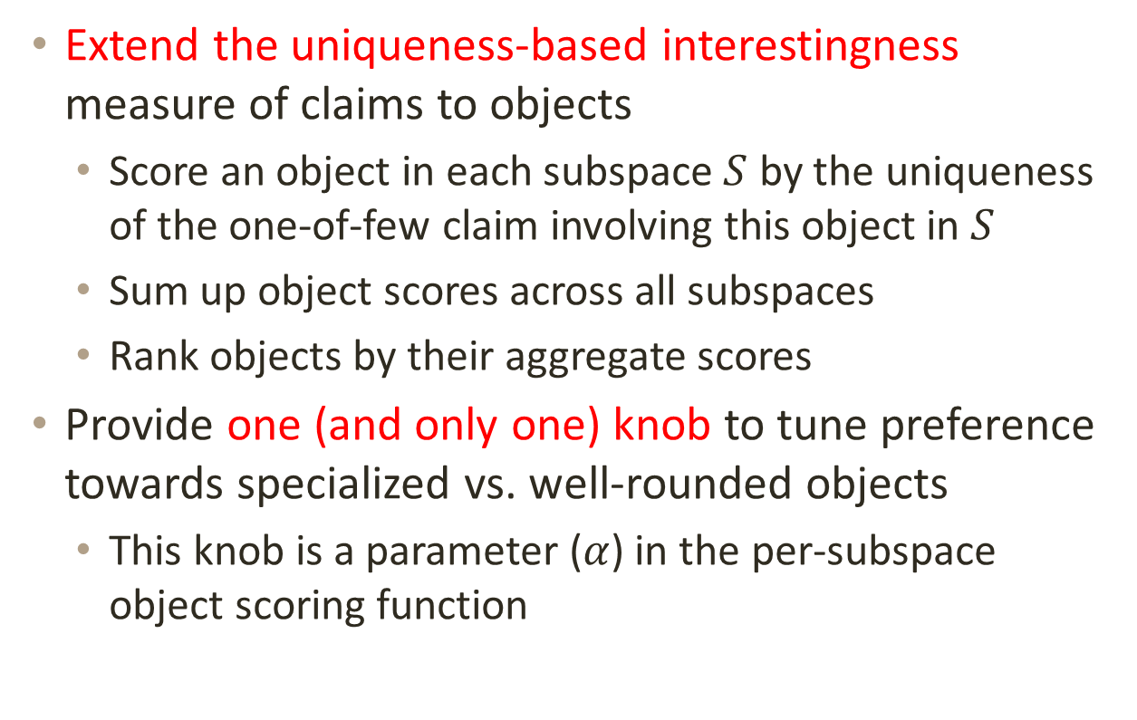
Our Approach
Extend the uniqueness-based interestingness measure of claims to objects
Score an object in each subspace $S$ by the uniqueness of the one-of-few claim involving this object in $S$
Sum up object scores across all subspaces
Rank objects by their aggregate scores
Provide one (and only one) knob to tune preference towards specialized vs. well-rounded objects
This knob is a parameter ($α$) in the per-subspace object scoring function

Slide 20



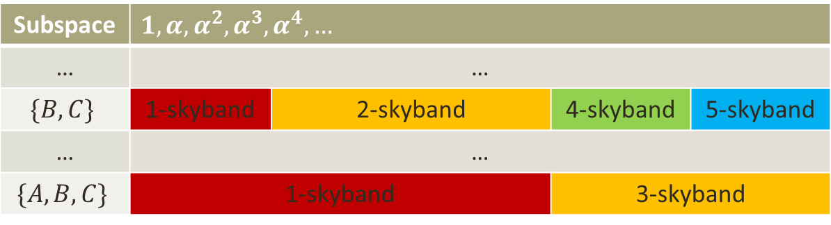


APST-$α$
All-Subspace Positional Score with Ties
In each subspace, order & score objects by skyband tiers
Score drops exponentially: position $i$ gets $α^{i−1}$ ($0<α<1$)
Objects in the same skyband tier (i.e., ties) divide up the total score for the tier equally
For each object, sum up its scores across all subspaces
$$⋆$$
Subspace | $$1,α,α^{2}, α^{3},α^{4},…$$
… | …
$$\{B,C\}$$ | 1-skyband | 2-skyband | 4-skyband | 5-skyband
… | …
$$\{A,B,C\}$$ | 1-skyband |  | 3-skyband
$$⋆$$
$$⋆$$
Notes:
Revisit kemeny, tuning advantage

Slide 21
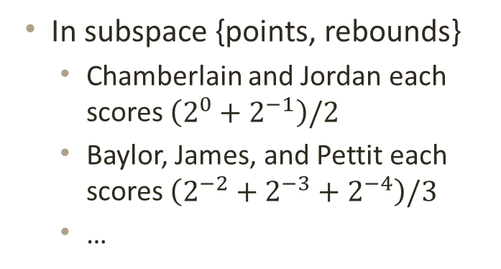
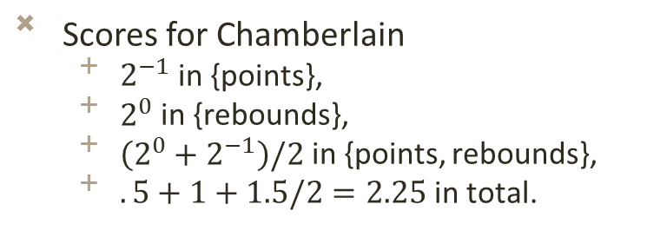
Scoring Example
Rank | Score | Object
1 | 2⁰ | Chamberlain
2 | 2⁻¹ | Jordan
3 | 2⁻² | Baylor
4 | 2⁻³ | James
5 | 2⁻⁴ | Pettit
6 | 2⁻⁵ | Abdul-Jabbar
7 | 2⁻⁶ | Robertson
8 | 2⁻⁷ | Bird
9 | 2⁻⁸ | Johnson
10 | 2⁻⁹ | Stockton
Chamberlain
Pettit
Baylor
Abdul-Jabbar
Bird
Johnson
James
Robertson
Jordan
Stockton
In subspace {points, rebounds}
Chamberlain and Jordan each scores $\left(2^{0}+2^{−1}\right)/2$
Baylor, James, and Pettit each scores $\left(2^{−2}+2^{−3}+2^{−4}\right)/3$
…
Scores for Chamberlain
$2^{−1}$ in {points},
$2^{0}$ in {rebounds},
$\left({2^{0}+2}^{−1}\right)/2$ in {points, rebounds},
$.5+1+1.5/2=2.25$ in total.

Slide 22

Rank of NBA players by APST-$α$

Slide 23
Quality of Ranking

Slide 24
Roadmap
Introduction
Identifying Interesting Claims
Ranking Objects
Conclusions and Future Work

Slide 25
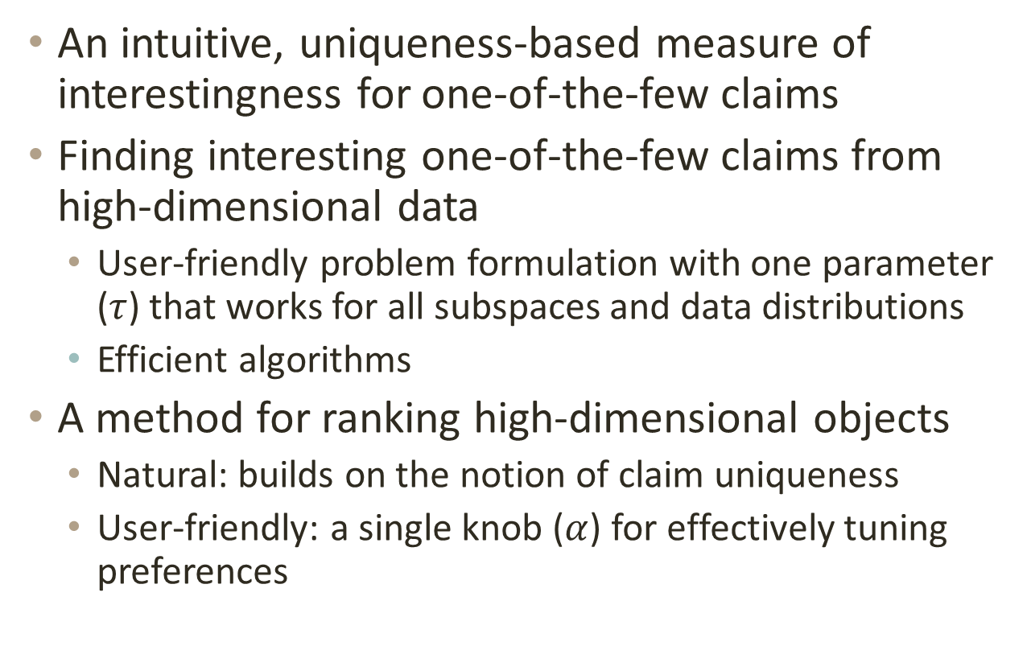
Main Contributions
An intuitive, uniqueness-based measure of interestingness for one-of-the-few claims
Finding interesting one-of-the-few claims from high-dimensional data
User-friendly problem formulation with one parameter ($τ$) that works for all subspaces and data distributions
Efficient algorithms
A method for ranking high-dimensional objects
Natural: builds on the notion of claim uniqueness
User-friendly: a single knob ($α$) for effectively tuning preferences

Slide 26
Future Work
Other criteria of interestingness
How many objects are begin considered?
E.g., all NBA players vs. point guards since 2000
How sensitive is the claim to perturbation in its parameters?
Other types of statements
Computational journalism project aimed at automating fact-checking and fact-finding

Slide 27
Thank You!
Questions?

Slide 28
Mining Interesting Statements
Subgroup discovery
A person who smokes and has family history has a high chance of having coronary heart disease. [Atzmueller, 2005]
Redescription mining
Russia and China are the only two countries which “have land area > 3,000,000 square miles outside of the America” or “are Permanent members of the UN security council who have a history of communism” [Parida et al., 2005]
Prominent streak discovery
“LeBron James scored 35 points in nine consecutive games and joined Michael Jordan and Kobe Bryant as the only players since 1970 to accomplish the feat” [Jiang et al., 2011]

Slide 29

Computing top-$τ$ skyband
Flow charts for the two algorithms
Progressive
OnePass
$$Φ$$
$$O\backslash Φ$$
Skyline of $O\backslash Φ$
$$ΔΦ$$
$$o$$
$$Φ$$
“peel off” last tier of $Φ+\left\{o\right\}$
Yes
No
Keep $o$?
$\left|Φ+\left\{o\right\}\right|≤τ$?
Yes
End of iteration

Slide 30
Skyline Layers vs. Skyband tiers
Color by skyband tiers
Color by skyline layers

Slide 31






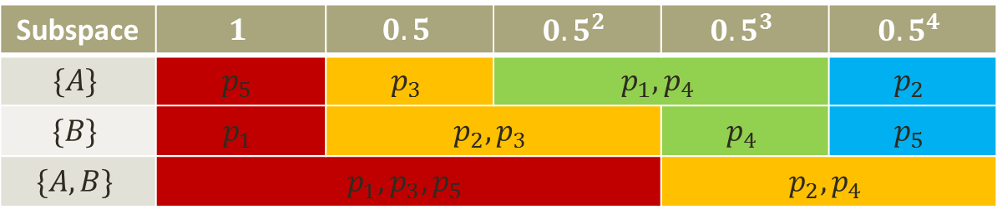




APST-$α$ Scoring Example
$$B$$
$$p_{1}$$
$α=0.5$
E.g. score for $p_{1}$
$s_{p_{1},\left\{A\right\}}=({0.5}^{2}+{0.5}^{3})/2$
$s_{p_{1},\left\{B\right\}}=1$
$s_{p_{1},\left\{A,B\right\}}=(1+0.5+{0.5}^{2})/3$
Total score ${Score}_{p_{1}}=\sum_{S⊆\left\{A,B\right\},S≠∅}{s_{p_{1},S}}$
$$p_{2}$$
$$p_{3}$$
$$p_{4}$$
$$p_{5}$$
$$A$$
Subspace | $$1$$ | $$0.5$$ | $$0.5^{2}$$ | $$0.5^{3}$$ | $$0.5^{4}$$
$$\{A\}$$ | $$p_{5}$$ | $$p_{3}$$ | $$p_{1},p_{4}$$ |  | $$p_{2}$$
$$\{B\}$$ | $$p_{1}$$ | $$p_{2},p_{3}$$ |  | $$p_{4}$$ | $$p_{5}$$
$$\{A,B\}$$ | $$p_{1},p_{3},p_{5}$$ |  |  | $$p_{2},p_{4}$$
$$⋆$$
$$⋆$$
$$⋆$$
Notes:
Revisit kemeny, tuning advantage

Slide 32
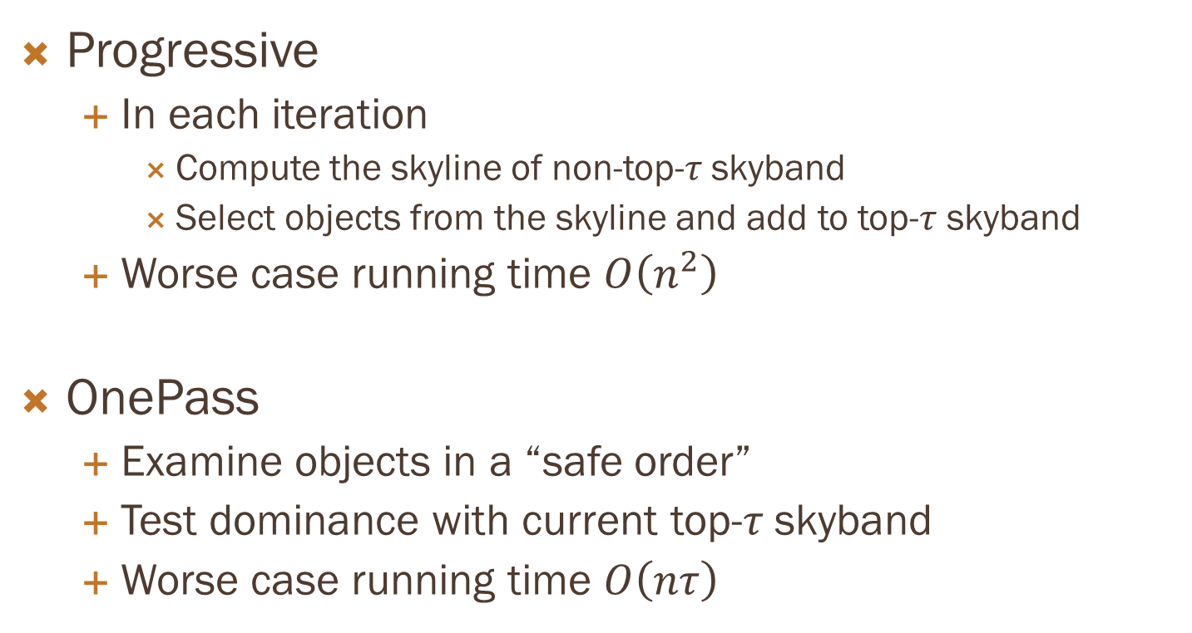
Algorithms (for one subspace)
Progressive
In each iteration
Compute the skyline of non-top-$τ$ skyband
Select objects from the skyline and add to top-$τ$ skyband
Worse case running time $O\left(n^{2}\right)$
OnePass
Examine objects in a “safe order”
Test dominance with current top-$τ$ skyband
Worse case running time $O\left(nτ\right)$

Slide 33
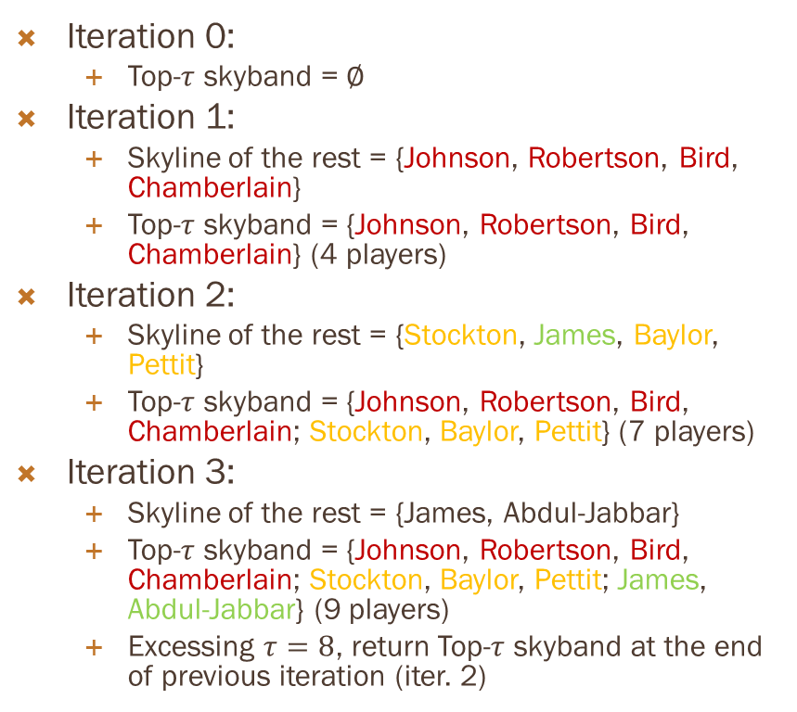

Progressive example ($τ=8)$
Iteration 0:
Top-$τ$ skyband = $∅$
Iteration 1:
Skyline of the rest = {Johnson, Robertson, Bird, Chamberlain}
Top-$τ$ skyband = {Johnson, Robertson, Bird, Chamberlain} (4 players)
Iteration 2:
Skyline of the rest = {Stockton, James, Baylor, Pettit}
Top-$τ$ skyband = {Johnson, Robertson, Bird, Chamberlain; Stockton, Baylor, Pettit} (7 players)
Iteration 3:
Skyline of the rest = {James, Abdul-Jabbar}
Top-$τ$ skyband = {Johnson, Robertson, Bird, Chamberlain; Stockton, Baylor, Pettit; James, Abdul-Jabbar} (9 players)
Excessing $τ=8$, return Top-$τ$ skyband at the end of previous iteration (iter. 2)
Stockton
Robertson
James
Bird
Jordan
Baylor
Chamberlain
Abdul-Jabbar
Pettit

Slide 34

OnePass example ($τ=8)$
Stockton
Examine points in order: Johnson, Stockton, Robertson, James, Bird, Jordan, Chamberlain, Baylor, Abdul-Jabbar, Pettit
Robertson
James
Bird
Player | # dom.
Johnson | 0
Stockton | 1
Robertson | 0
James | 2
Jordan
Chamberlain
Player | # dom.
Johnson | 0
Baylor
Abdul-Jabbar
Pettit
Player | # dom.
Johnson | 0
Stockton | 1
Player | # dom.
Johnson | 0
Stockton | 1
Robertson | 0
James | 2
Bird | 0
Jordan | 3
Player | # dom.
Johnson | 0
Stockton | 1
Robertson | 0
James | 2
Bird | 0
Player | # dom.
Johnson | 0
Stockton | 1
Robertson | 0

Slide 35
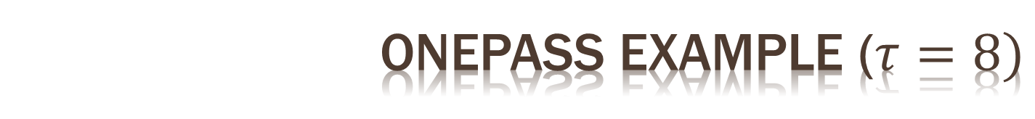
OnePass example ($τ=8)$
Stockton
Robertson
James
Bird
Jordan
Chamberlain
Player | # dom.
Johnson | 0
Stockton | 1
Robertson | 0
James | 2
Bird | 0
Chamberlain | 0
Baylor | 1
Abdul-Jabbar | 2
Pettit | 1
Baylor
Abdul-Jabbar
Pettit
Player | # dom.
Johnson | 0
Stockton | 1
Robertson | 0
James | 2
Bird | 0
Jordan | 3
Chamberlain | 0
Baylor | 1
Abdul-Jabbar | 2
Player | # dom.
Johnson | 0
Stockton | 1
Robertson | 0
James | 2
Bird | 0
Jordan | 3
Chamberlain | 0
Baylor | 1
Player | # dom.
Johnson | 0
Stockton | 1
Robertson | 0
James | 2
Bird | 0
Jordan | 3
Chamberlain | 0

Slide 36
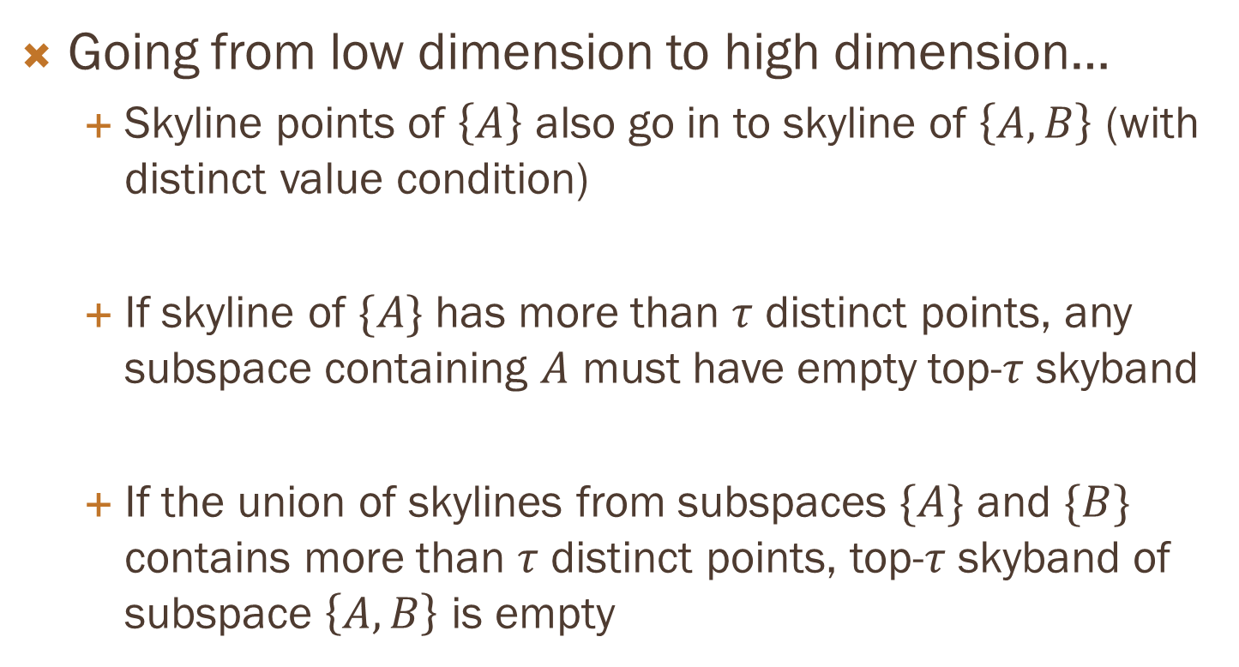
Lattice Traversal
Going from low dimension to high dimension…
Skyline points of $\left\{A\right\}$ also go in to skyline of $\left\{A,B\right\}$ (with distinct value condition)
If skyline of $\{A\}$ has more than $τ$ distinct points, any subspace containing $A$ must have empty top-$τ$ skyband
If the union of skylines from subspaces $\{A\}$ and $\{B\}$ contains more than $τ$ distinct points, top-$τ$ skyband of subspace $\left\{A,B\right\}$ is empty
Notes:
Put in more intuitions here, with examples

Slide 37
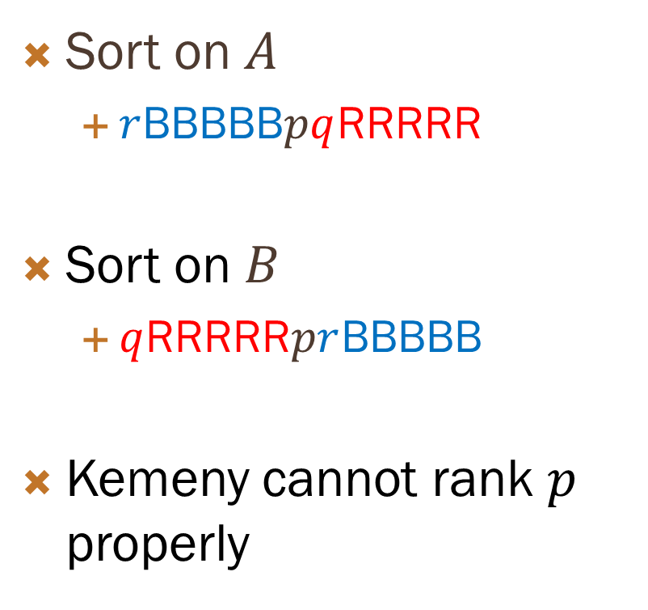





Special case for kemeny
Sort on $A$
$r$BBBBB$pq$RRRRR
Sort on $B$
$q$RRRRR$pr$BBBBB
Kemeny cannot rank $p$ properly
$$B$$
$$q$$
$$p$$
$$r$$
$$A$$

Slide 38
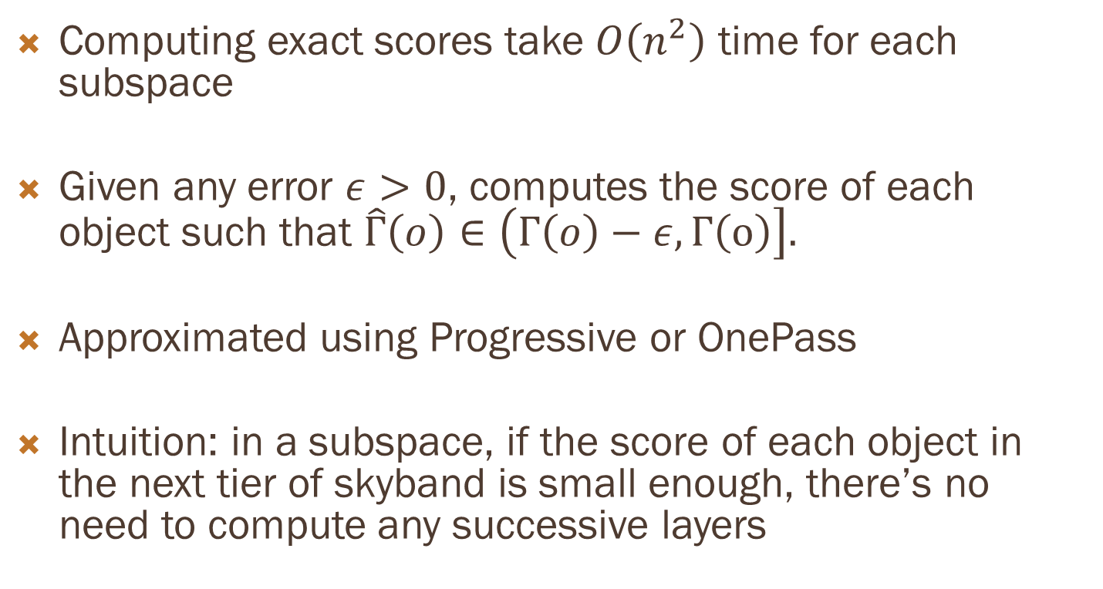
Computing APST scores
Computing exact scores take $O\left(n^{2}\right)$ time for each subspace
Given any error $ε>0$, computes the score of each object such that $\hat{Γ}\left(o\right)∈\left(Γ\left(o\right)−ε, Γ\left(o\right)\right].$
Approximated using Progressive or OnePass
Intuition: in a subspace, if the score of each object in the next tier of skyband is small enough, there’s no need to compute any successive layers

Slide 39

Performance (NBA)
$$τ$$

Slide 40

Performance (correlated)
$$τ$$

Slide 41

Performance (Independent)
$$τ$$

